Slide 1
Microservices Architecture
Janani

Slide 2
Agenda
Monolithic Applications
Decomposed into Microservices
Benefits
Drawbacks

Slide 3
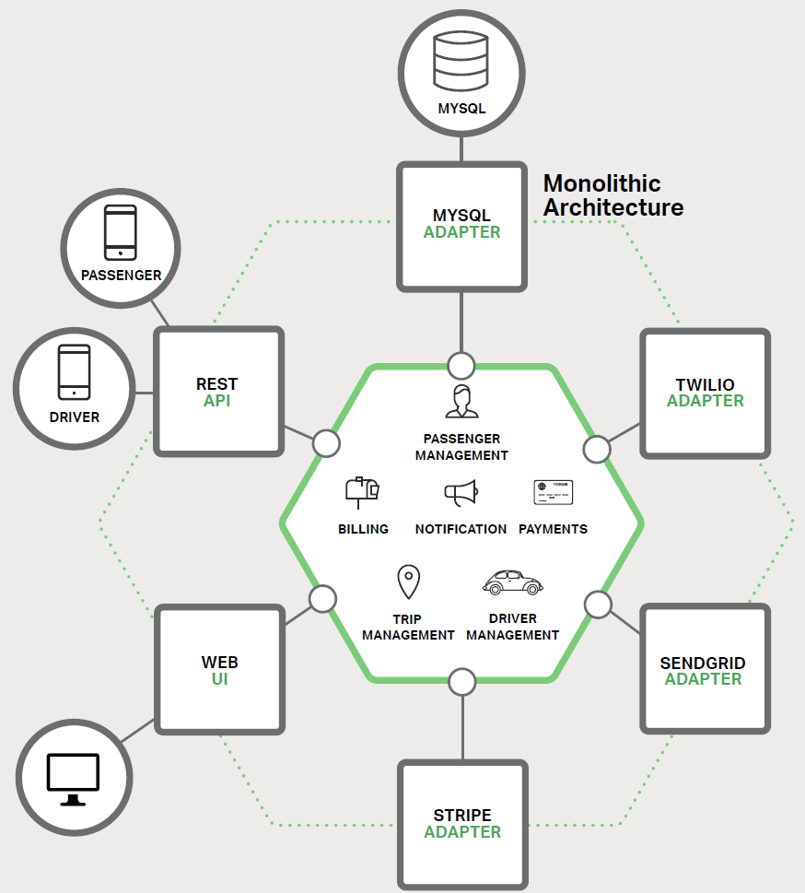
Monolithic Applications
Large & Complex
Bug fixing
Implementing new features
Slow down
Difficulty in Continuous Deployment
Difficult to scale
Reliability Problems
Difficult to adopt

Slide 4
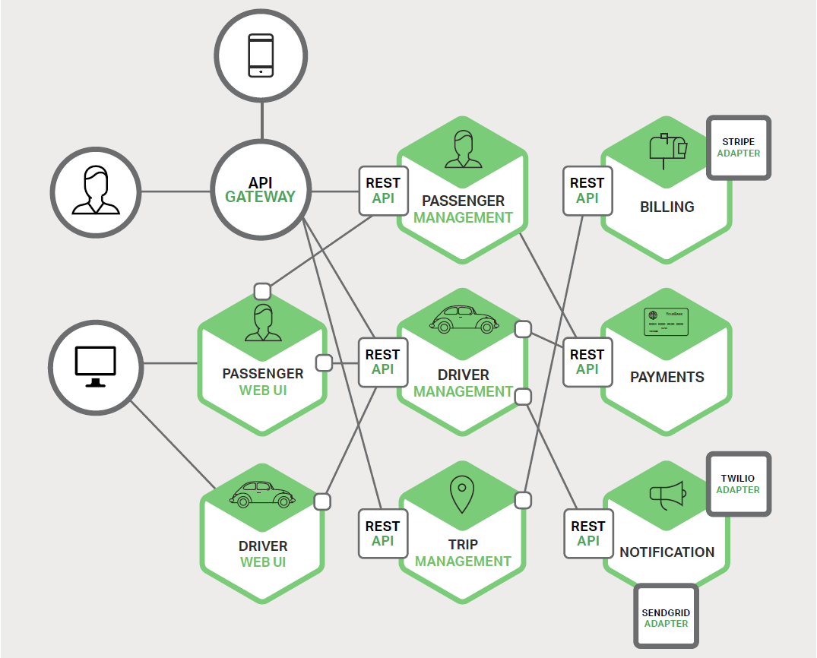
Decomposed into Microservices
Simple & Easy
Easier bug fixing
Faster implementation
Continuous Deployment
Difficult to scale
Reliable
Easily adopt new tech

Slide 5



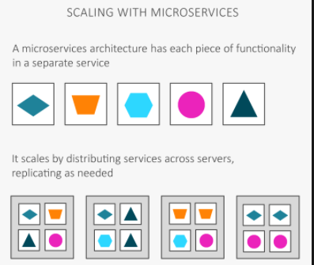
Benefits
Tackles complexity
Focus on a service
Continuous Deployment
Independent Scaling

Slide 6
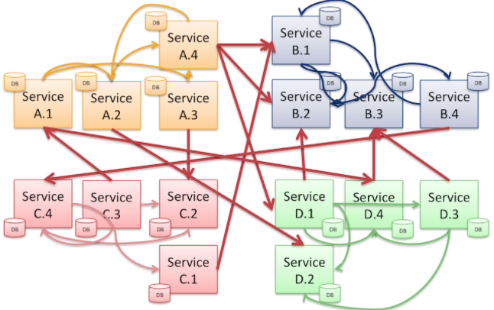
Drawbacks
Name itself
Inter-process communication
Partitioned DB architecture
Testing
Rollout of changes
Complex deployment

Slide 7
Thank You

